Slide 1
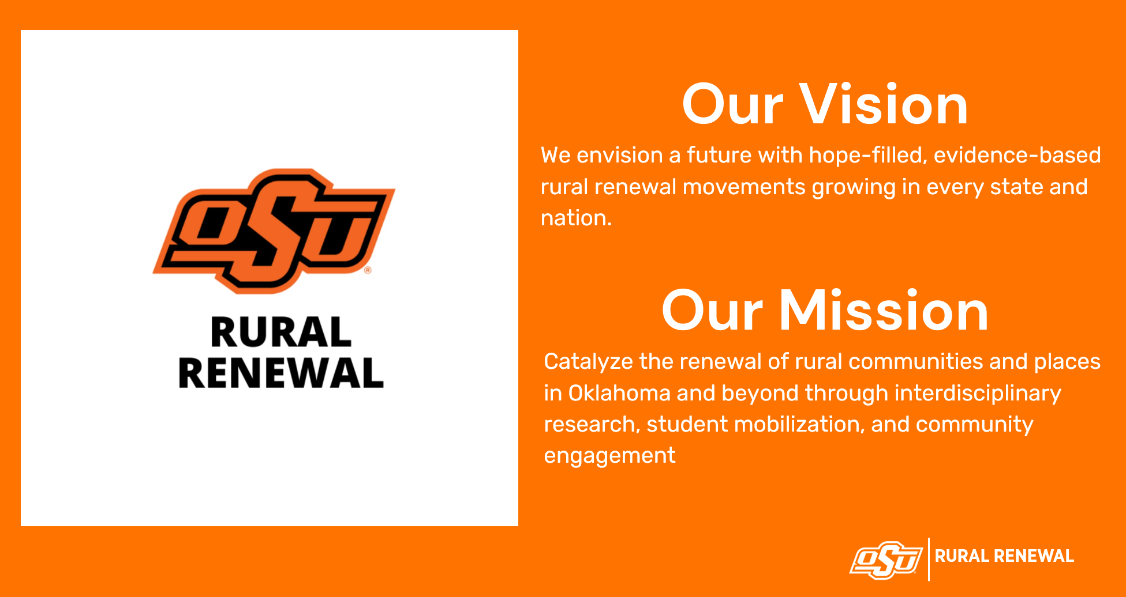
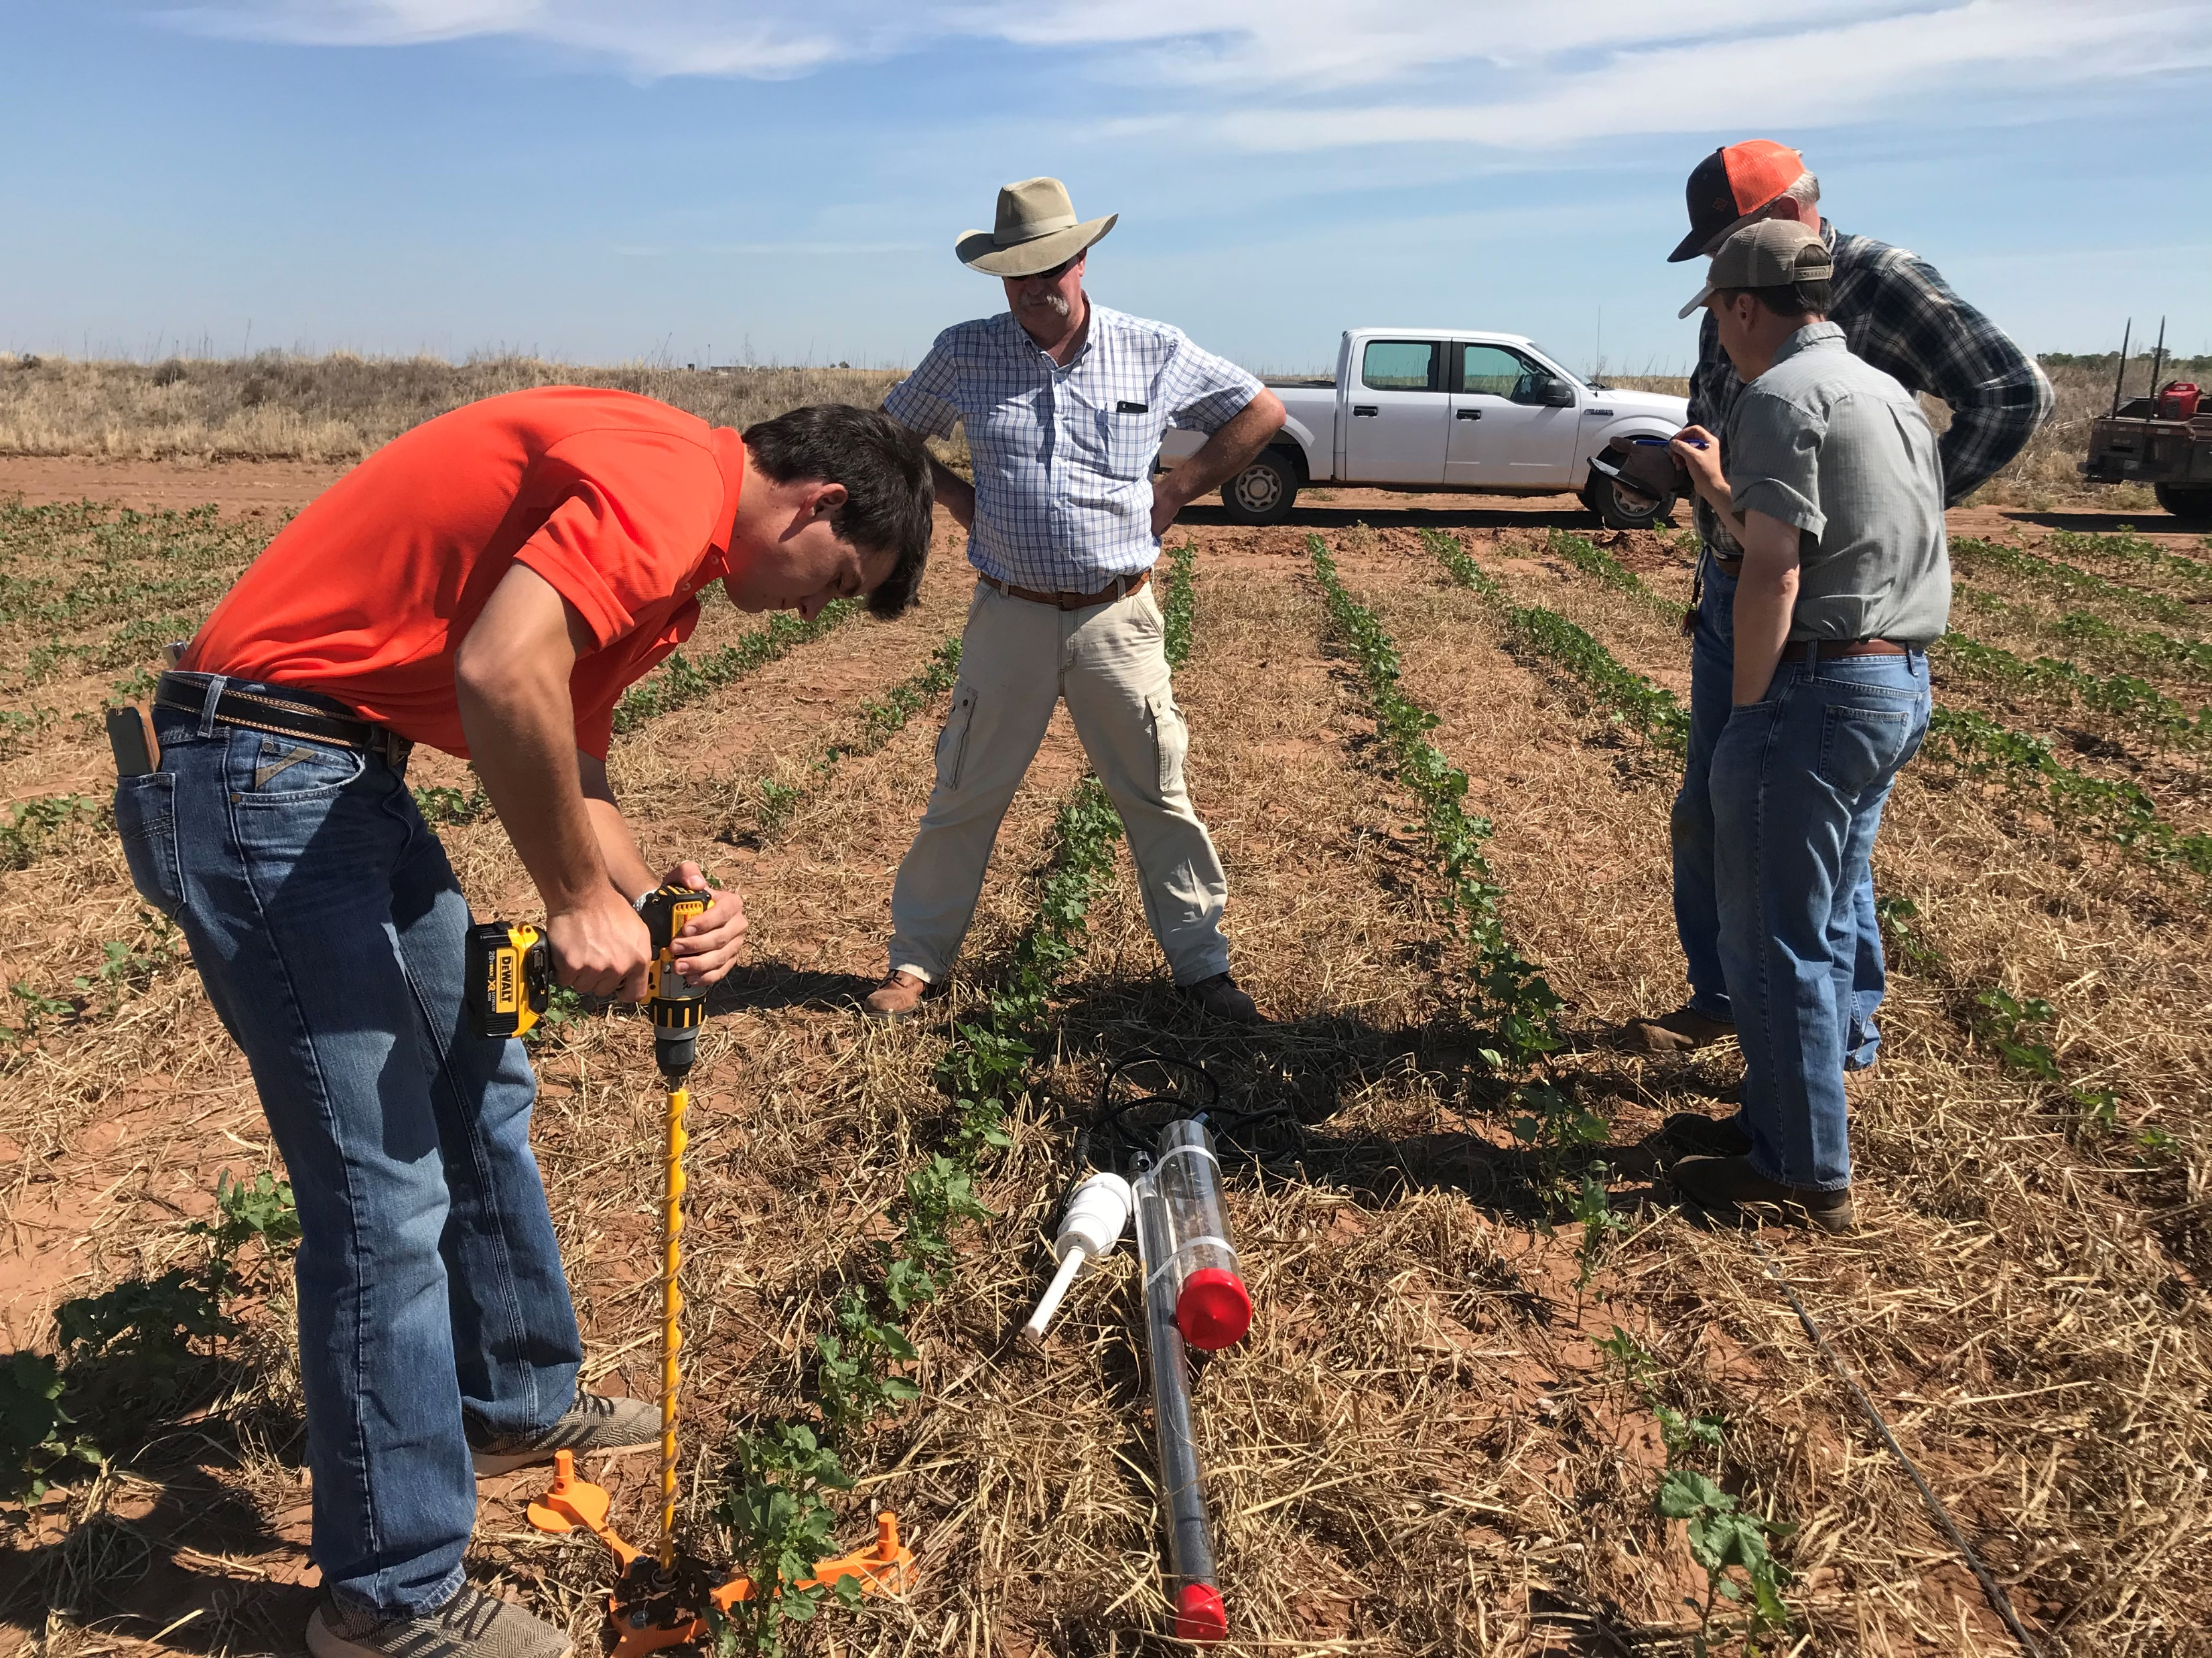
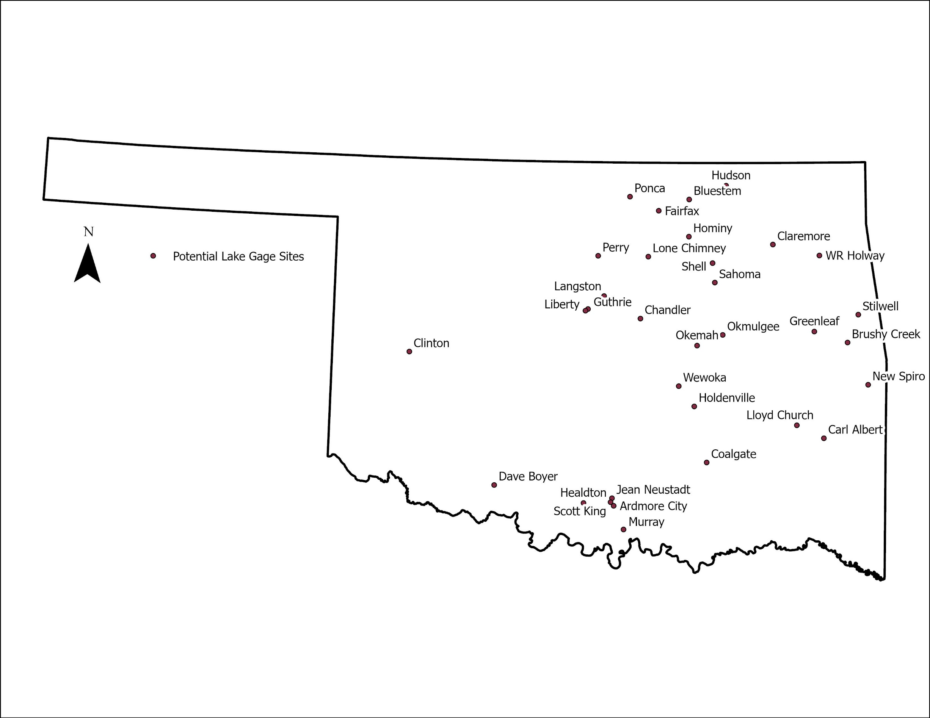
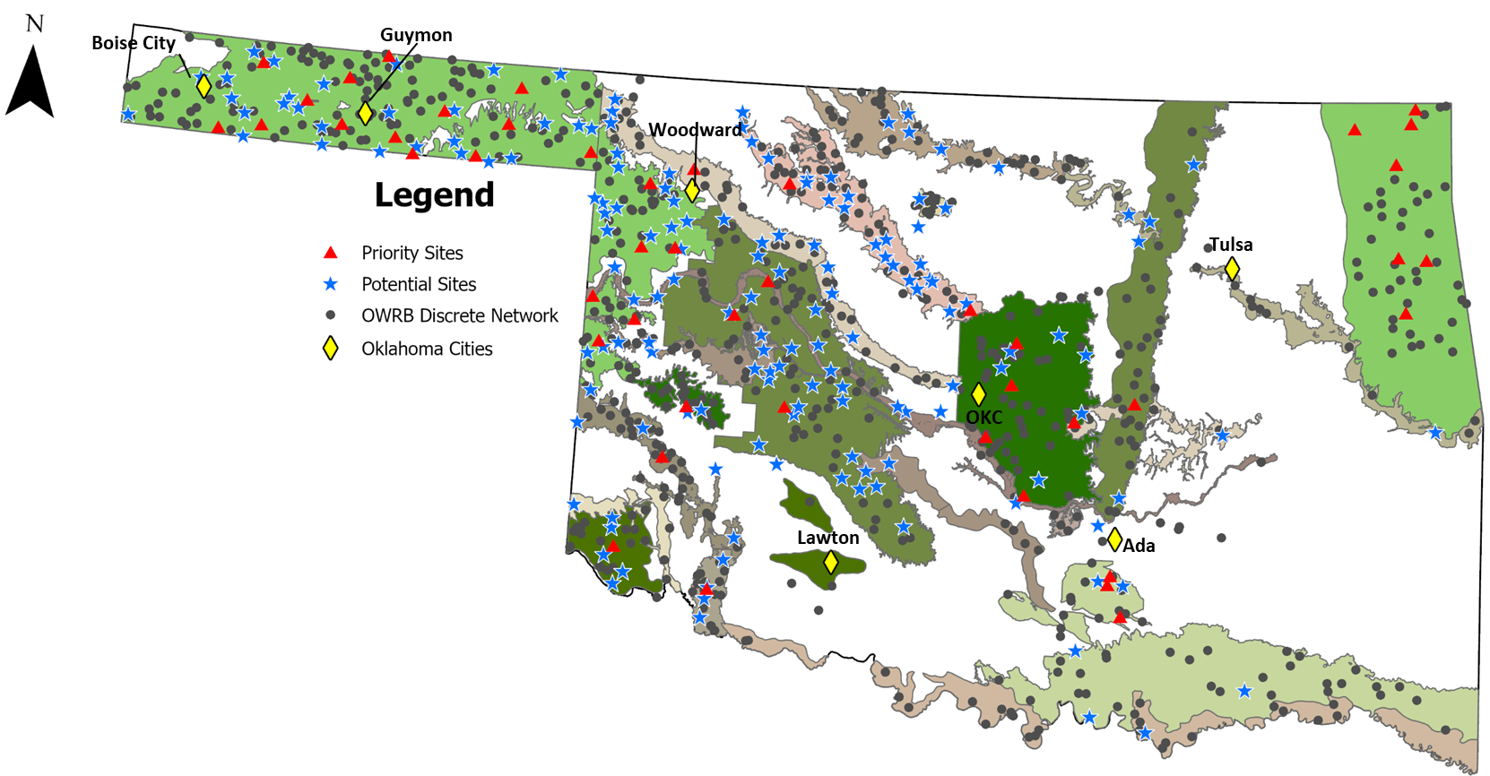
https://ruralrenewal.okstate.edu/
Oklahoma Hydronet
Surface water storage
Ground water storage
Soil water storage

Slide 2
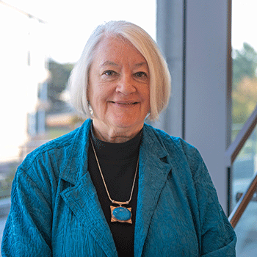








Mary Emery
Rural Prosperity Nebraska
Nina Lam
Louisiana State University
https://ruralrenewal.okstate.edu/
Our mission is to advance rural climate resilience science and build resilience capacity in rural communities.
tyson.ochsner@okstate.edu

