Slide 1
STRATEGIES FOR SUCCESSFUL Poster TALKS
Hanson Center for Technical Communication
Scott Coffel, Director
Sarah Livesay, Assistant Director
University of Iowa, College of Engineering
Special thanks to: Kasra Zarei

Slide 2
Workshop overview
Workshop description:
In other words, this presentation will:
“In addition to helping you visually represent your research project, this workshop provides advice for communicating with clarity and insight.”
Provide direction on the layout on the poster.
Provide guidance for the communication of the poster.

Slide 3
Audience Poll
How many of you:
participate in undergraduate research?
are presenting at an upcoming poster session?
have presented your work before?

Slide 4
Benefits of Presentations
Poster presentations give the speaker the opportunity to:
Organize knowledge for the benefit of others.
Motivate audiences to ask questions.
Build credibility as a subject matter expert.

Slide 5
Purpose of Poster Presentation
Introduces your question.
Communicates your research.
Provides an overview of your approach.
Summarizes your results.
Discusses your results.
Lists published articles important to your research.
Acknowledges assistance and support.
Source: Purrington, C. (2017). Designing Conference Posters [Blog post]. Retrieved from https://colinpurrington.com/tips/poster-design.
Notes:
Question should be interesting, attention-getting, and new.
Research should be easy to summarize for lay people.
Approach should be novel!
A summary means that it is not exhaustive. The viewer and listener wants this information distilled.
Discussion
Published articles
Assistance and support are financial, time, or other things meaningful to the completion of this project.

Slide 6
Length of Poster
Ideally, the average audience member could read your entire poster in under 5 minutes.

Slide 7
Included on Poster
Miscellany: title bar, authorship, affiliations, logos, acknowledgements
Abstract (not always required)
Introduction/Background
Methods/Materials
Results
Conclusions/Discussion
References

Slide 8
Retrieved from: file:///D:/Documents/Administrative/PPTs/scientific-poster-advice-purrington.pdf.
Notes:
Point out:
Title
Font size and style
General look/feel (some color, white space, clearly outlined boxes)

Slide 9
Visual Guidelines
save extra words for an article!
Limit the words on your poster.
Revise several times.
Ensure that it is readable from a few yards away.
Do not use first person.
Tell a story about your research.
Notes:
There will be specific visual guidelines at the end of the presentation. This is a brief overview.

Slide 10
Poster Talk
The Spoken Presentation

Slide 11
Speaking Overview
Introduce your subject with an attention-getting question, statistic, or image.
Explain what the audience can expect to learn.
Repeat what they should remember.
Conclude with a memorable message.

Slide 12
Audience Struggles
Listening requires work.
Too much or disorganized information hinders comprehension.
Listeners think faster than you can speak.
Notes:
So what can you do?
Be aware
Slow down
Repeat

Slide 13
Who is your Audience?
Can you tailor your presentation to them?
Can you use analogies that help them relate?
Can you make references to work in their field?
Notes:
Speaking to colleagues gives you more freedom to use specialized terms without providing definitions or context.
Speaking to a general audience allows you to convince those outside your field of the importance of your project.
The ability to shift gears for different audiences is a quality of a successful communicator.

Slide 14
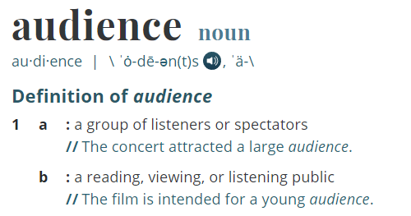
Speak to your audience
Speak as if to non-engineers
Repeat main ideas
Define terms
Audience. 2019. In Merriam-Webster’s online dictionary. Retrieved from https://www.merriam-webster.com/dictionary/audience.
Notes:
Non-engineers could also mean people not in your specific field. This is likely to be anyone who judges or reads your poster.
Audience members will almost always prefer to be spoken to without much jargon or technicality.

Slide 15
Delivery
Practice
Practice
Practice

Slide 16
Practice Presenting
Practice your speech with someone who is familiar and someone who is not familiar with your work.
Develop a hook that will lead from your introduction into your background.
Describe your methods in the order you performed them.
Verbally tie your results back to your background section.
Postulate about the future of your work.

Slide 17
Delivering Your Introduction
Does the introduction:
Prompt interest in the project?
Forecast what your listeners can expect to learn?
Adopt a tone appropriate to the audience?

Slide 18
Delivering your Presentation
Does the body of your presentation:
Give your audience a map and help them understand the relationship of one topic with another?
Define key terms and concepts?
Visualize your subject from multiple perspectives?

Slide 19
Delivering your Conclusion
Does your conclusion:
Discuss your results?
Remind your audience of your initial objectives and how you achieved them?
Forecast the future of your research?
Notes:
Check this slide

Slide 20
Speaking Resources
University of Mary Washington Speaking Program Handouts
University of Iowa Speaking Center Resources
University of North Carolina Greensboro Speaking Tip Sheets

Slide 21
Questions?

Slide 22
Visit the Hanson Center
3307 SC
Sign up online for an appointment: https://hanson.mywconline.com

Slide 23
Poster Text
The Written Presentation

Slide 24
Crafting your Title
Write a list of keywords and key points that have been demonstrated by the study.
Preserve the technicalities of your work, but do not over-explain.
Draft a few titles and have someone review them before deciding on a final version.
Save writing the title until the end of the poster-drafting process.

Slide 25
Introduction
Start with the problem that your study addresses.
Describe the current research in this area.
Mention any established models that you are using.
Narrow in on your specific research question, hypothesis, and the purpose of your study.
Describe previous research studies, shortcomings in your research question, and other possible results of a literature search.

Slide 26
Methods
Describe the techniques used.
Include information about sample sizes used for data analysis.
Use a data flow diagram.
Be as concise as possible, but still include the elements necessary to allow replication of the results.

Slide 27
Results
Present your results as figures and additional statistics.
Do not interpret your results, because any discussion should be saved for the conclusions section.

Slide 28
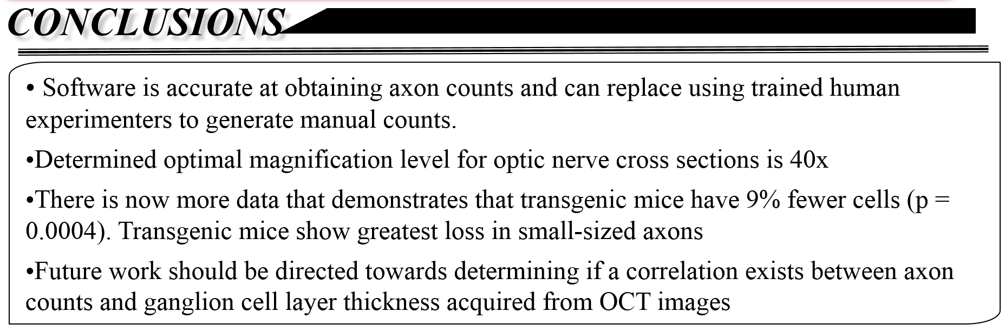
Conclusions
Focus on what you demonstrated in your study.
Reiterate the major statistics from your data analysis.

